Slide 1
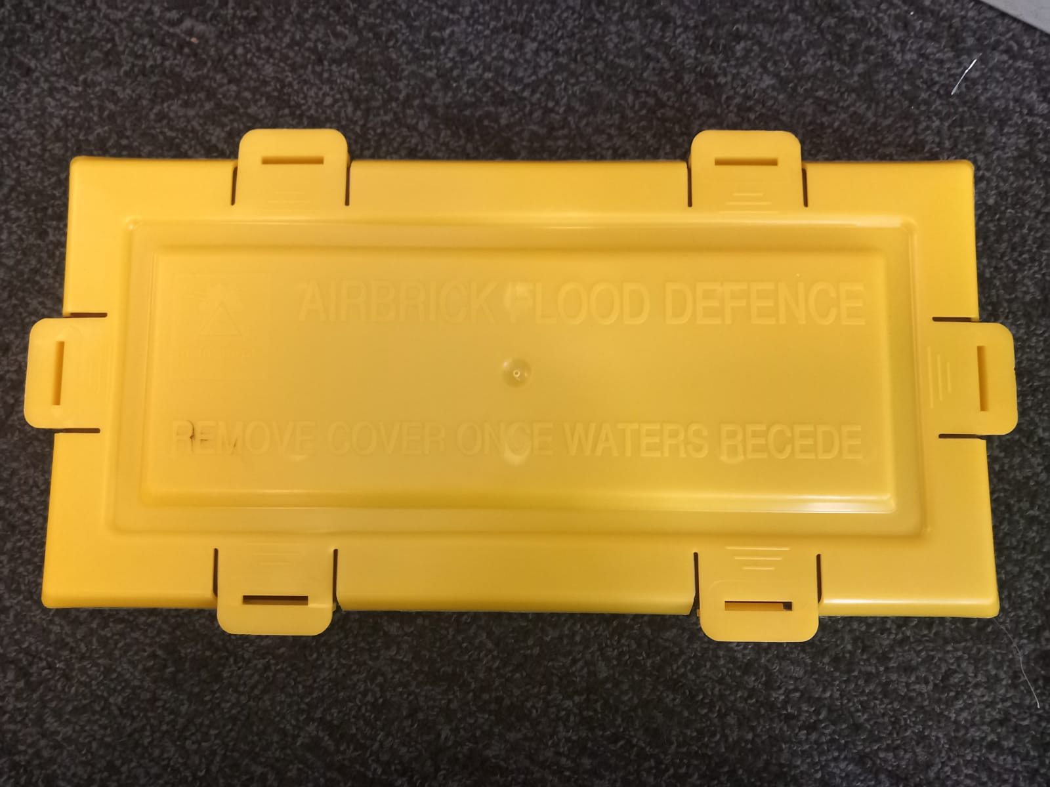
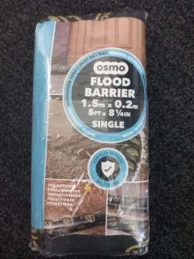
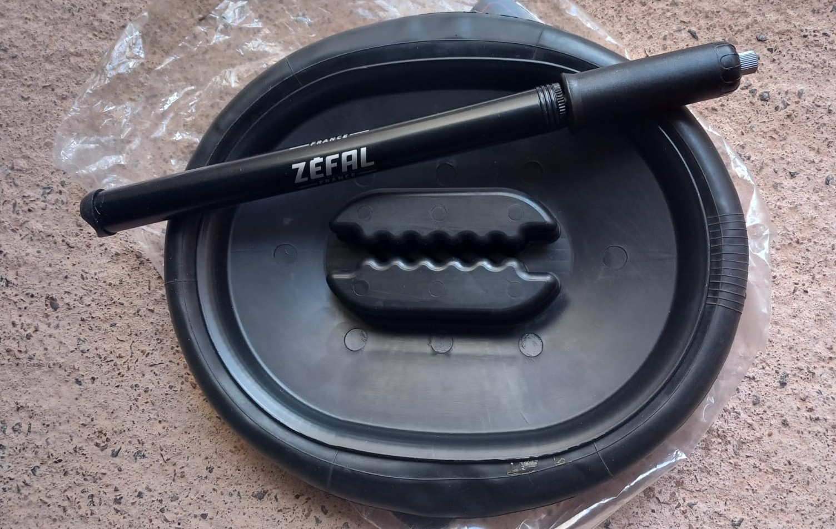
Flooding Resilience Roadshow for Homes
At Stoke St Mary Village Hall on Wednesday 20 May 2026
Pop-in / Pop-out from 2.30pm to 6.30pm
Displays of home flood defence equipment,
advice from experts at Somerset Rivers Authority
and the Emergency Volunteer Action Group.
Home flood defence presentations
at 3.30pm and 5.45pm
Sponsored by Stoke St Mary Parish Council,
Somerset Rivers Authority and the Emergency Volunteer Action Group
Any questions?
Email: cllr.graeme.watt@stokestmaryparish.gov.uk
Information on Free Home Surveys from EVAG
Information on Grants for
Emergency Equipment

